Slide 1
All You Need is Java
Fast-paced Switchover from C++
Md. Saidul Hoque Anik
onix.hoque.mist@gmail.com

Slide 2
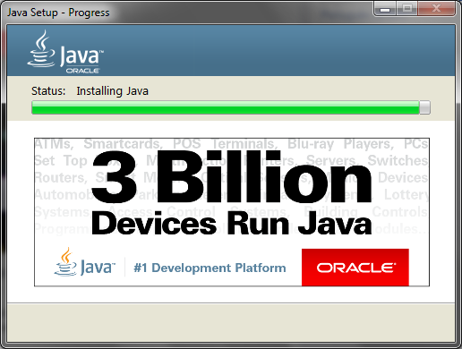
Why is Java everywhere?

Slide 3
Compilation Process
Non-JVM based Languages:
Source Code
Compiler
Executable Code
Executable on the target machine only
JVM based Languages:
Java
Compiler
Just-in-time
Compiler
Source
Code
Java
ByteCode
Executable Code
Executable on any JVM
(Java Virtual Machine)

Slide 4
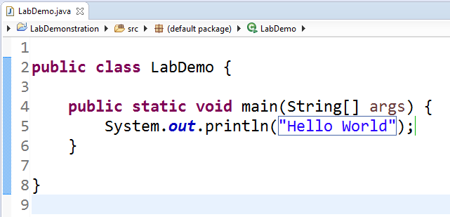
A Hello World Application

Slide 5
Data-types
Integers*: byte, short, int, long
Floating-point: float, double
Characters: char
Boolean: boolean
*Does not support unsigned (positive only) integers

Slide 6
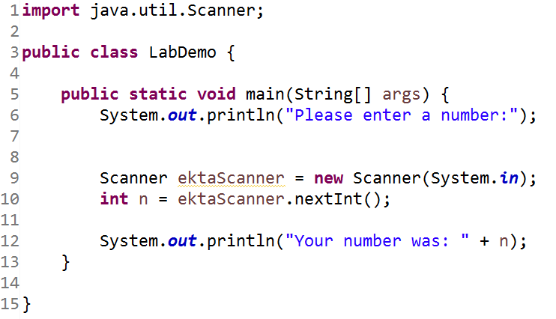
Taking input from user

Slide 7
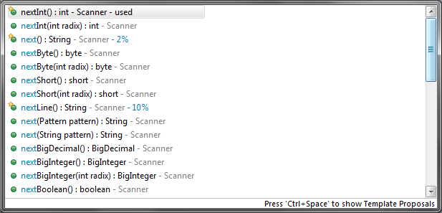
Taking input from user

Slide 8
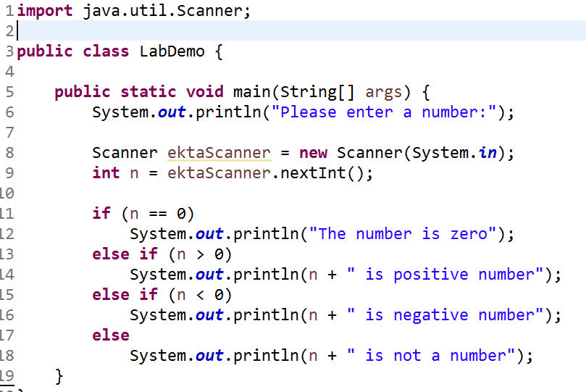
Control Statements (1/2)

Slide 9
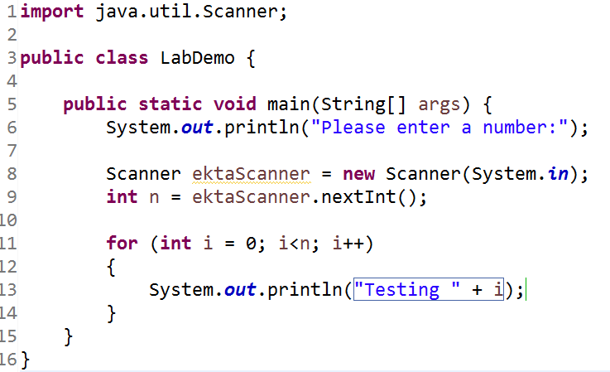
Control Statements (2/2)

Slide 10
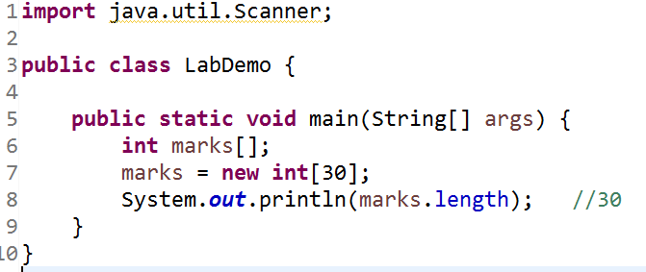
Arrays

Slide 11
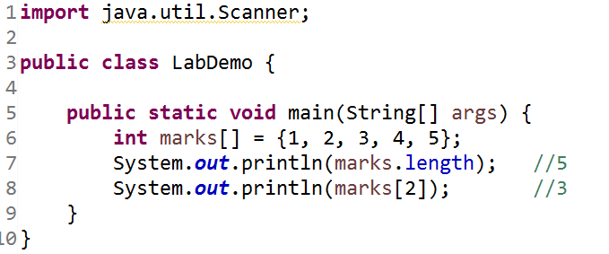
Arrays

Slide 12
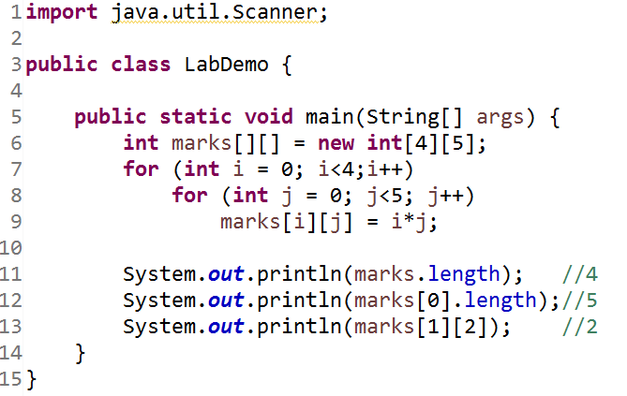
2D Array

Slide 13
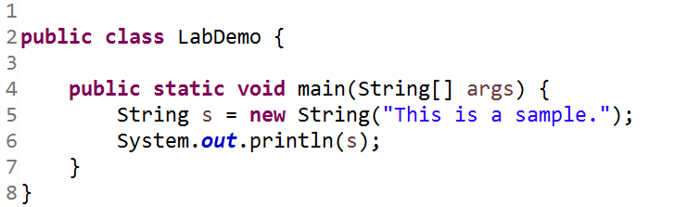
String

Slide 14
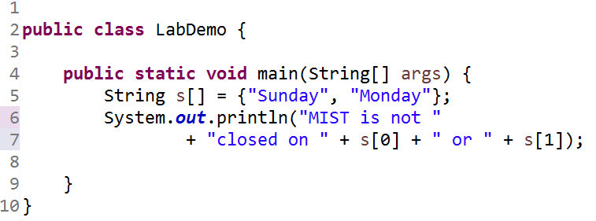
Array of String

